Slide 1
ATM Fraud Detection System
MAHARAJ VIJAYARAM GAJAPATHI RAJ COLLEGE OF ENGINEERING
MAJOR PROJECT Group Number-13
BY:
GUIDE:
Dr. D. Rama Devi Prof
M.Tech., Ph.D
HOD
ECE
23335A0414- P.SIVA SAI KRISHNA
22331A04H0-T.VARSHITHA
22331A04H6-V.BHARGAV
22331A04F3-S.DILEEP

Slide 2
Introduction
Automated Teller Machines (ATMs) are widely used but remain vulnerable to fraud through stolen cards, PIN theft, and spoofing. Traditional security (card + PIN) is insufficient against modern threats. Biometrics like fingerprints and iris are accurate but costly.
Our project proposes a multi-factor authentication system integrating RFID card, keypad PIN, and AI-based face recognition with Arduino-controlled GSM alerts and buzzer mechanisms. Unlike existing works, our approach is low-cost, real-time, and combines Machine Learning, Embedded Systems, and IoT into a single secure ATM prototype.

Slide 3
Literature Survey:
Title: “Face Recognition Based ATM Authentication System” – A. Singh et al., IEEE, 2019
Method: Haar Cascade for face detection
Limitation: Poor accuracy in low light, easy spoofing with photos
Gap: Need for more robust deep learning techniques
Our Contribution: Use CNN/HOG-based face encoding for higher accuracy

Slide 4
Paper 2(Contd.)
Title: “Smart ATM Security Using IoT and Biometrics” – R. Sharma et al., IEEE, 2020
Method: Fingerprint + GSM-based IoT alerts
Limitation: Fingerprint hardware is costly, GSM delay in rural areas
Gap: Cheaper biometric like face, offline-capable system
Our Contribution: Use webcam-based face recognition + offline GSM alerts

Slide 5
Paper 3(Contd.)
Title: “Deep Learning Based Real-Time Face Recognition for ATM” – P. Patel et al., IEEE, 2021
Method: CNN (TensorFlow/Keras) on GPU
Limitation: High cost (GPU required), not portable
Gap: Need low-cost implementation on basic hardware
Our Contribution: Run face recognition on normal PC webcam (HOG/CNN lightweight model)

Slide 6
Paper 4(Contd.)
Title: “IoT-based Fraud Detection in ATM Machines” – K. Verma et al., IEEE, 2022
Method: IoT sensors for intrusion detection
Limitation: Detects tampering but no user authentication
Gap: No link between fraud detection and user identity
Our Contribution: Add multi-factor authentication (RFID+PIN+Face) + fraud alerts

Slide 7
Paper 5(Contd.)
Title: “Multi-factor Authentication in ATM Transactions” – S. Reddy et al., IEEE, 2023
Method: Card + OTP via Internet
Limitation: Requires network, delays in remote/rural areas
Gap: Need an offline alert + authentication system
Our Contribution: PIN + Face + GSM SMS (offline, real-time)

Slide 8
Literature Survey Summary (Table)
Author & Year | Title | Method | Limitation | Our Contribution
A. Singh et al., 2019 (IEEE) | "Face Recognition Based ATM Authentication System" | Used Haar Cascade for face detection | Poor accuracy in low light | We use CNN/HOG for better accuracy
R. Sharma et al., 2020 (IEEE) | "Smart ATM Security Using IoT and Biometrics" | GSM alerts + fingerprint | Costly hardware, slow response | Low-cost RFID + PIN + face ML
P. Patel et al., 2021 (IEEE) | "Deep Learning Based Real-Time Face Recognition for ATM" | CNN (TensorFlow) | High hardware cost (GPU) | Low-cost PC webcam solution
K. Verma et al., 2022 (IEEE) | "IoT-based Fraud Detection in ATM Machines" | IoT + motion sensors | No biometric verification | Added face recognition layer
S. Reddy et al., 2023 (IEEE) | "Multi-factor Authentication in ATM Transactions" | Card + OTP | Needs internet, delay in rural areas | Offline PIN + face combo with GSM backup

Slide 9
From these papers, we observed most systems either lack accuracy, are costly, or need internet. Our work overcomes these by combining RFID + PIN + Face Recognition + GSM in a single low-cost prototype.

Slide 10
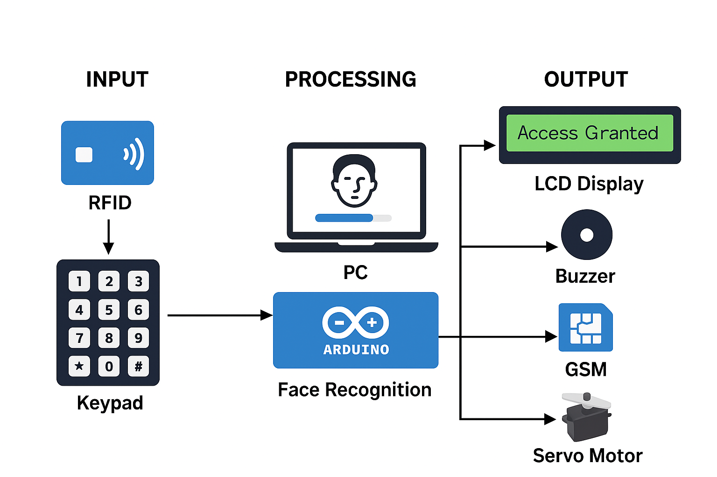
Proposed Workflow:
1.Scan RFID
2.Enter PIN
3.Capture Face (8–10s window)
4.ML recognition (CNN/HOG)
5.If valid → Access Granted (servo open)
6.If invalid → Buzzer + GSM alert

Slide 11
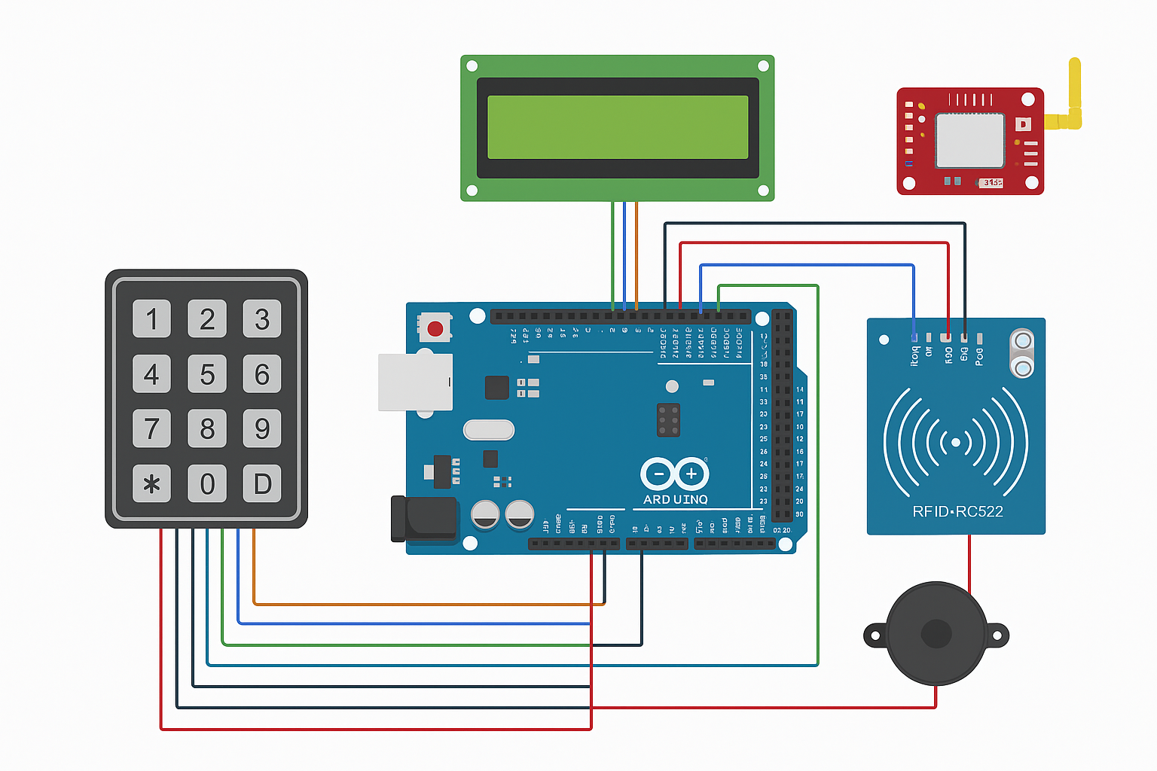
Proposed Circuit Diagram:

Slide 12
Hardware Components Used:
Arduino Mega (Controller)
RFID Reader (RC522) + RFID Tags
4x4 Keypad
LCD Display (16x2 or 20x4)
GSM Module (SIM800L/SIM900)
Buzzer + Servo Motor (lock)
Laptop Webcam (for face recognition, handled by PC)

Slide 13
Software Tools Used
Arduino IDE (for hardware programming)
Python (OpenCV + face_recognition library)
Serial Communication (PC ↔ Arduino)

Slide 14
Research Gap & Our Contribution:
Combines Embedded + ML + GSM (not found together in previous works)
Works offline (no cloud required)
Uses majority voting in face recognition (avoids false alarms)
Provides real-time alerts

Slide 15
Future Scope
Add liveness detection (blink/eye movement) to prevent photo spoofing
Cloud integration for centralized logging
Extend to fingerprint/iris for stronger multi-biometric system
Deploy on Raspberry Pi for portable ATM unit

Slide 16
Thank You

